Slide 1

Unified Database API
A unified REST API for relational and NoSQL data stores
By:
Amit Kumar Gupta – 1DS16CS704
Mohammed Ataaur Rahaman – 1DS16CS721
Sanjitha Singh A – 1DS16CS739
Guide: Prof. Ravichandra H.
Batch: Shift-1 (S1)
Area of Project: Big Data and Cloud Computing
Department of Computer Science & Engineering, DSCE

Slide 2
Unified Database API
Unified Database API - UDAPI - is a uniform API that provides a uniform language based on REST requests for interaction with different types of databases. The databases could be relational like MySQL and PostGres; or non-relational like MongoDB and Couch DB.
Department of Computer Science & Engineering, DSCE

Slide 3
Goals of the Project
The project has 2 Important goals
Build UDAPI - a cross-database API which takes REST Requests as input and performs the required CRUD (Create, Retrieve, Update and Delete) operations by interacting with the necessary databases. The API returns the results of the query.
Build a sample front-end to demonstrate the functionality of the API. The front-end includes tools for viewing all the databases of a specific user, the entity sets of each database, the entities of each entity set.
Department of Computer Science & Engineering, DSCE

Slide 4
Problem Statement
In order to satisfy different storage requirements, cloud applications usually need to access and interact with different relational and NoSQL data stores having heterogeneous APIs. This APIs heterogeneity induces two main problems:
It makes migration from one data store to another complex. During migration, data has to migrated from the old data store to the new one. The application source code has to modified and adapted to the new proprietary API.
A cloud application may use multiple data stores at once—polyglot persistence. Polyglot Persistence means that when storing data, it is best to use multiple data storage technologies, chosen based upon the way data is being used by individual applications or components of a single application.
Department of Computer Science & Engineering, DSCE

Slide 5
Introduction
The API was first prototyped using the Spring framework - a java-based application framework.
There were certain limitations which caused it to be migrated to Flask framework - a python- based micro web framework.
The Flask framework handles the routes of the API and performs the necessary processing and query translation.
The processed and translated queries are wrapped and the low-level communication API for the different databases are invoked. There are numerous other steps that are involved in processing the requests which will be detailed in the other sections of the report.
Department of Computer Science & Engineering, DSCE

Slide 6
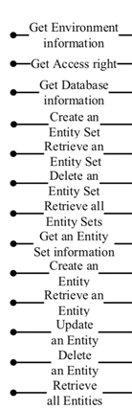





Block Diagram
SSH/telnet
UDAPI User Auth service
UDAPI
Spring Boot
+
Spring Security
+
Spring MVC + Flask
UI Service Node/Angular/React
My SQL
Redis
Mongo DB
Web Interface
Department of Computer Science & Engineering, DSCE

Slide 7
Scope of the Project
The API only interacts with two primarily kinds of databases : MySQL and MongoDB.
Therefore the project’s goals would be to allow CRUD operations only for these two data-stores. But the API has been built modularly to allow integration of various other data-stores.
Certain database operations such as JOINs are not allowed because they are not supported in NoSQL databases.
Department of Computer Science & Engineering, DSCE

Slide 8
Applications
The primary beneficiaries of the project are developers
The API can be used for Platform-As-A-Service (PAAS) applications by developers. The barebones API can be hit directly with the REST request and the results returned can be directly used in their applications.
The user-interface also allows programmers to view and monitor their different databases of different programming language in a simple dashboard. There are quick options to create databases, delete databases. CRUD operations can be performed for entities and entity sets from the front-end without having to write code. This will increase a programmer’s efficiency.
Department of Computer Science & Engineering, DSCE

Slide 9
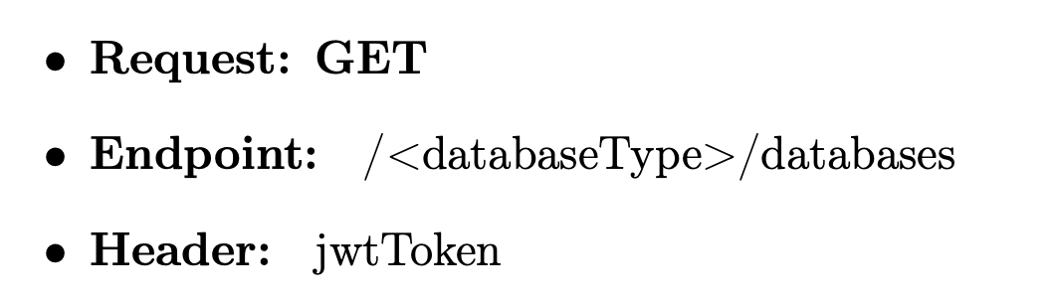
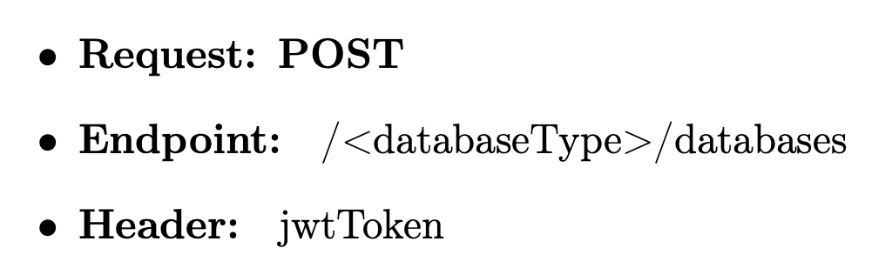
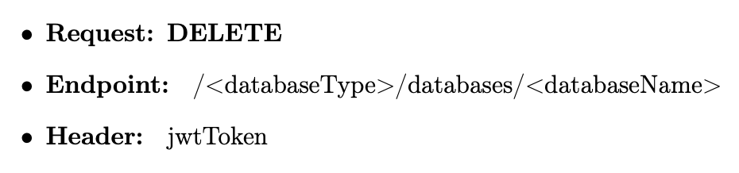
REST Request
REST stands for Representational State Transfer.
• GET - to retrieve resources • POST - to create a new resource • PUT - to modify an existing resource • DELETE - to delete an existing resource
Department of Computer Science & Engineering, DSCE

Slide 10
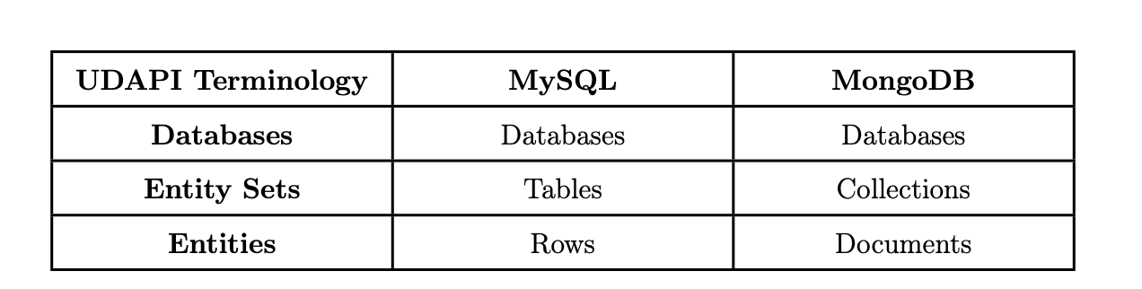
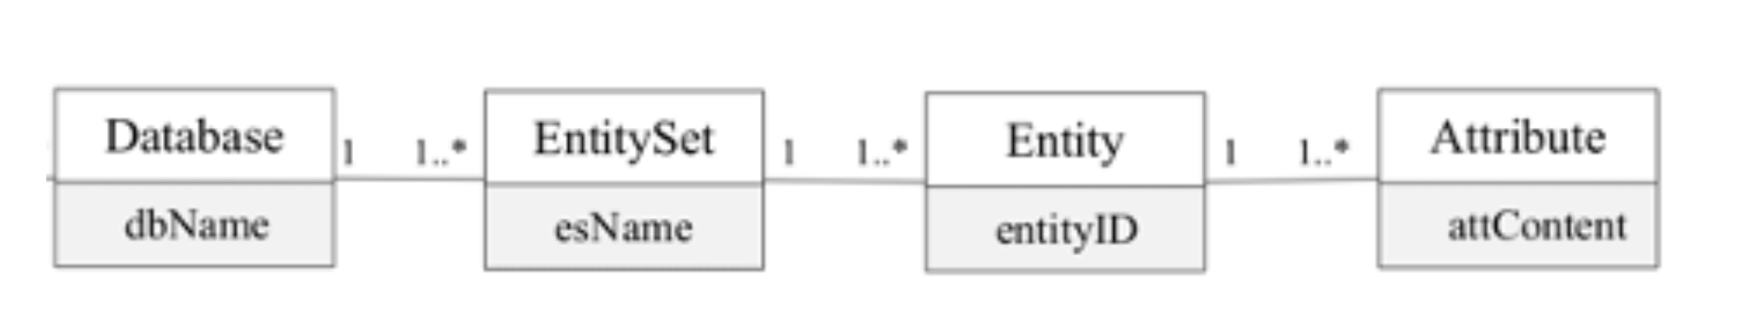
UDAPI Terminology
Department of Computer Science & Engineering, DSCE

Slide 11
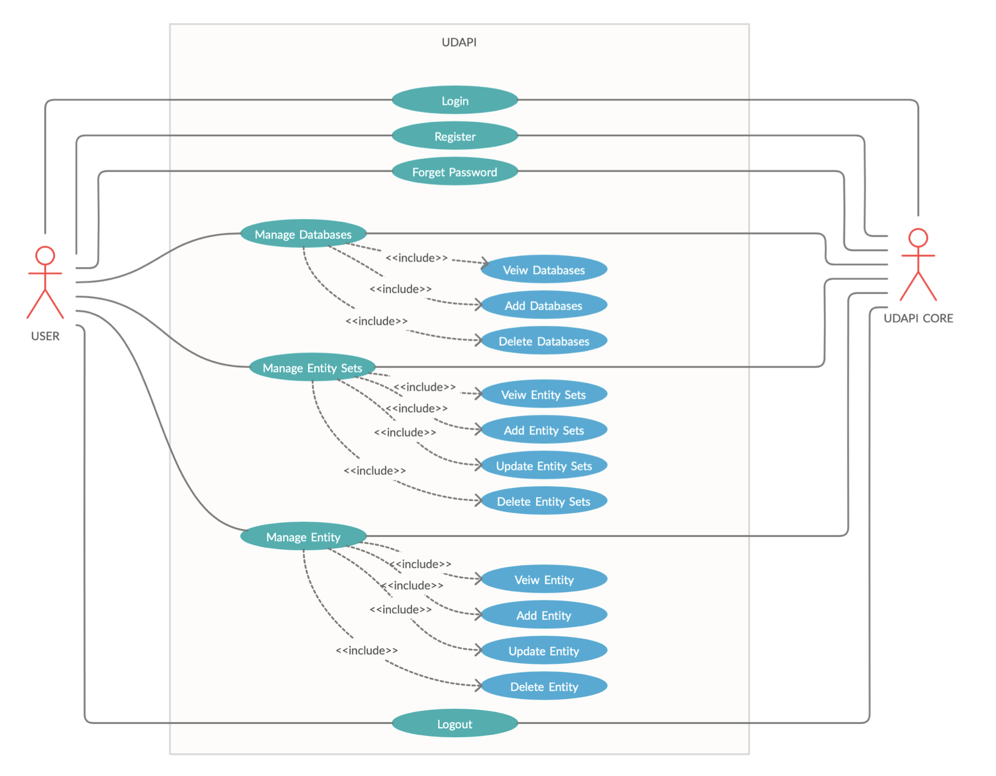
Use Case Diagram
Department of Computer Science & Engineering, DSCE

Slide 12
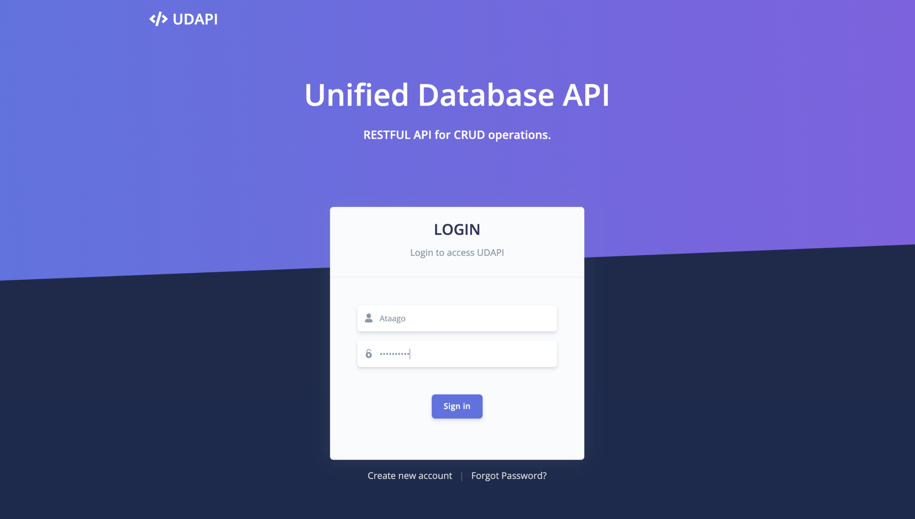
User Interface: Login page
Department of Computer Science & Engineering, DSCE

Slide 13
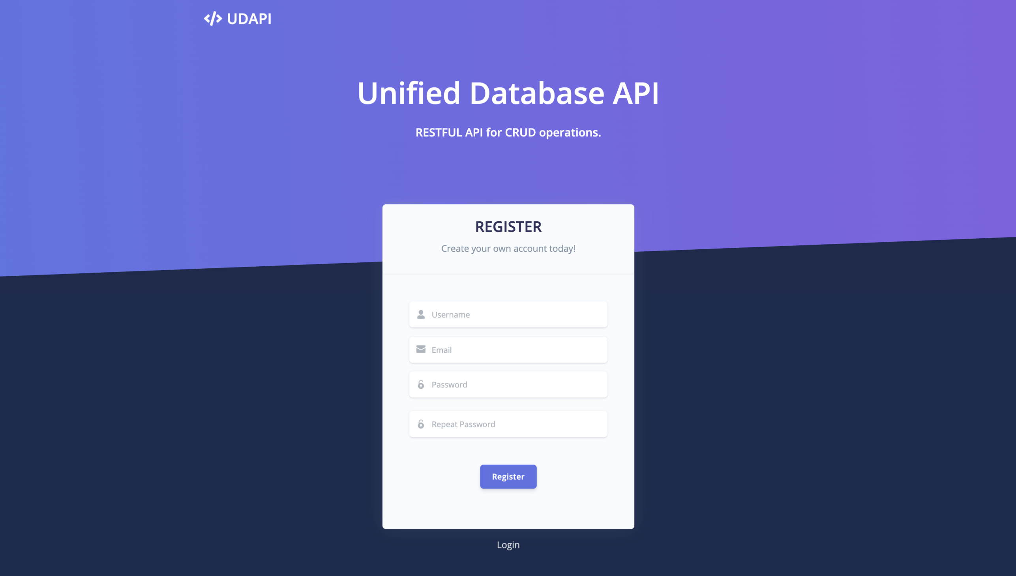
User Interface: Register page
Department of Computer Science & Engineering, DSCE

Slide 14
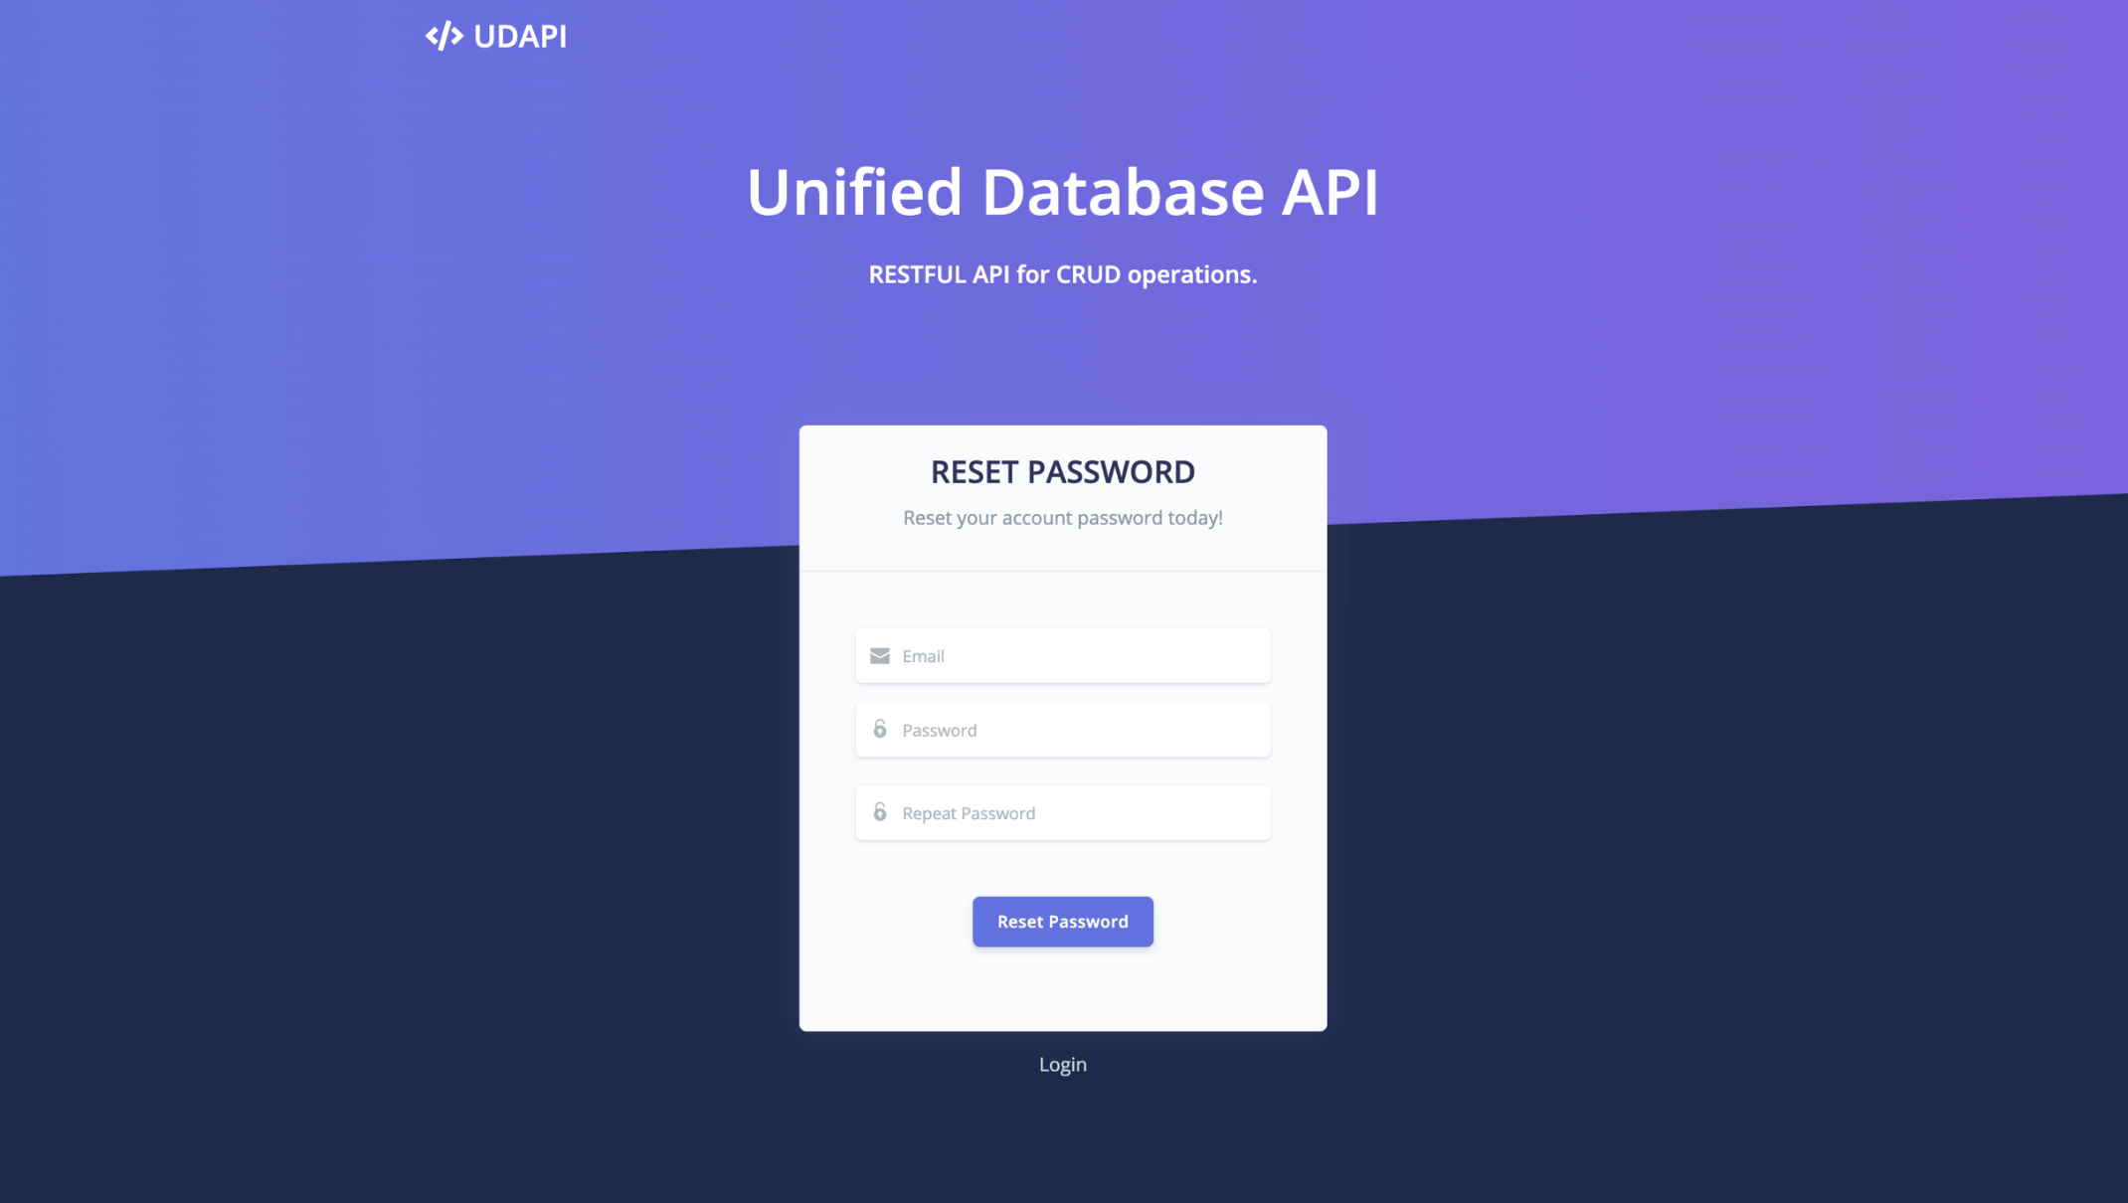
User Interface: Password reset
Department of Computer Science & Engineering, DSCE

Slide 15
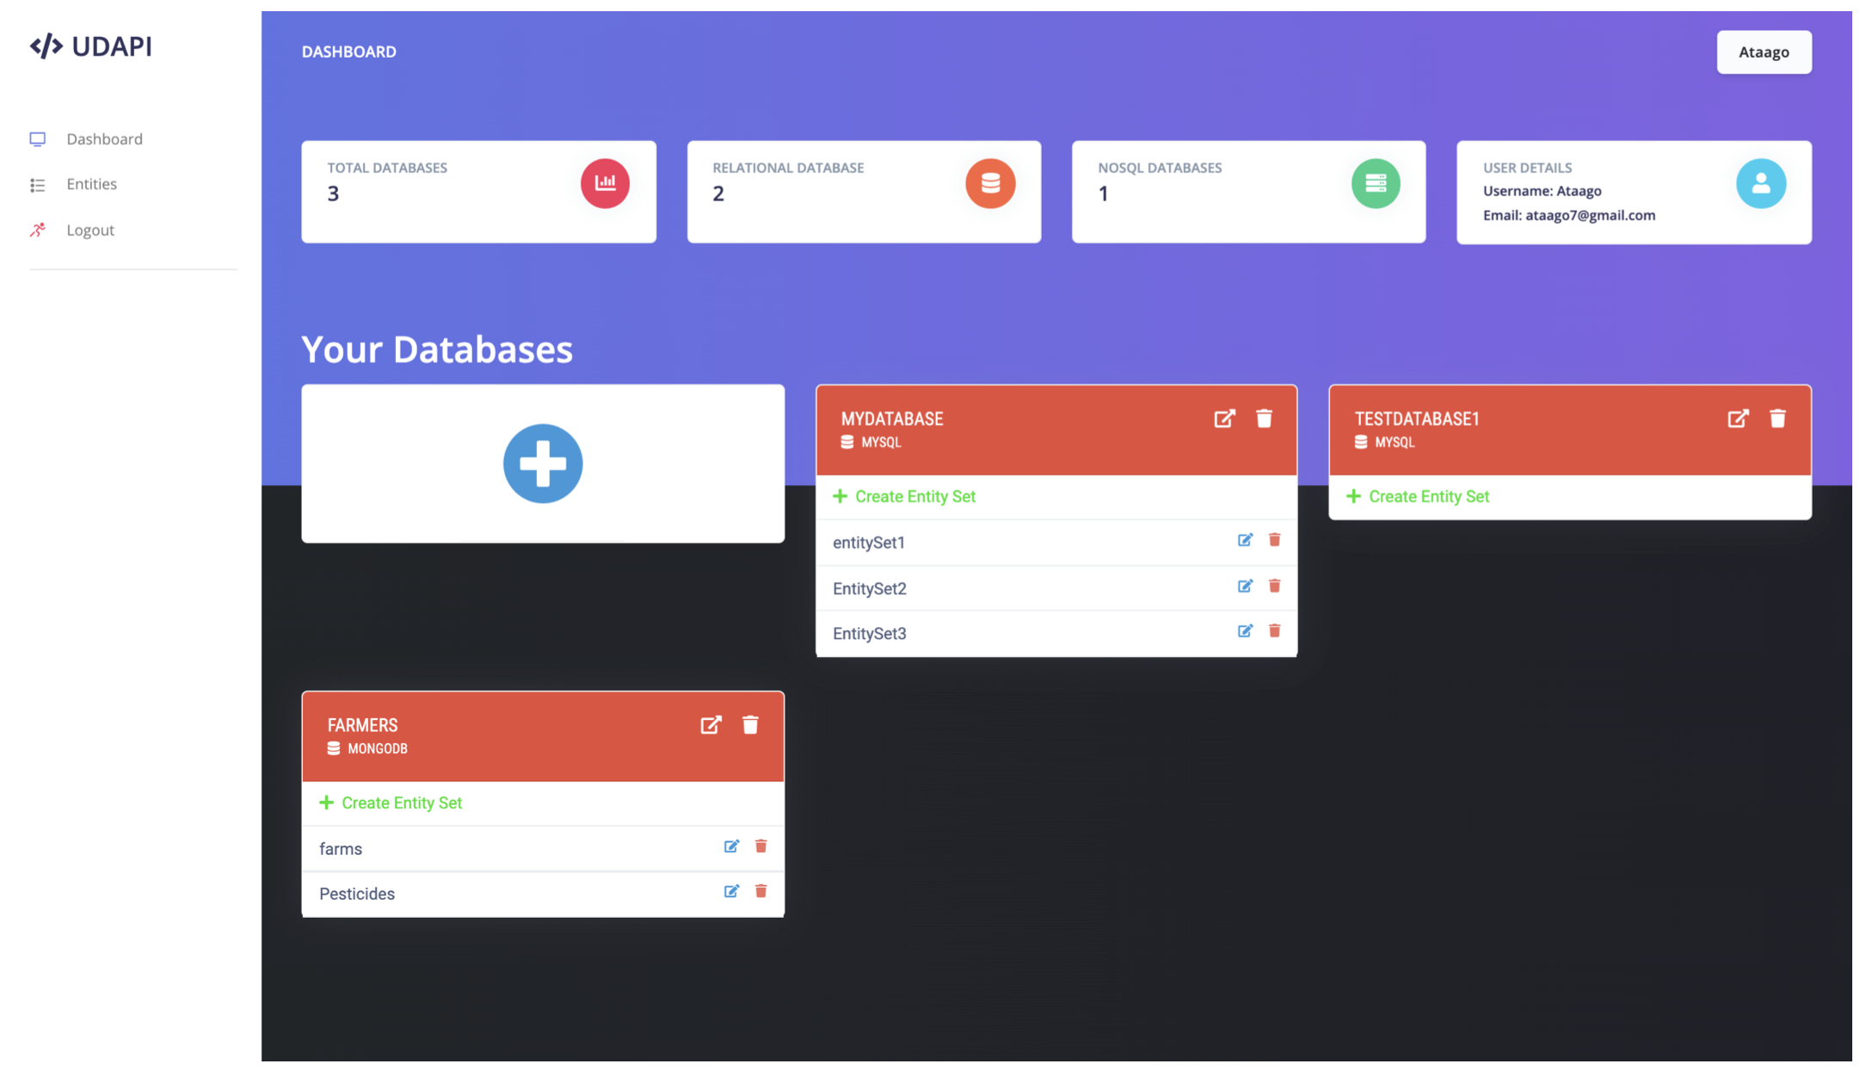
User Interface: Dashboard
Department of Computer Science & Engineering, DSCE

Slide 16
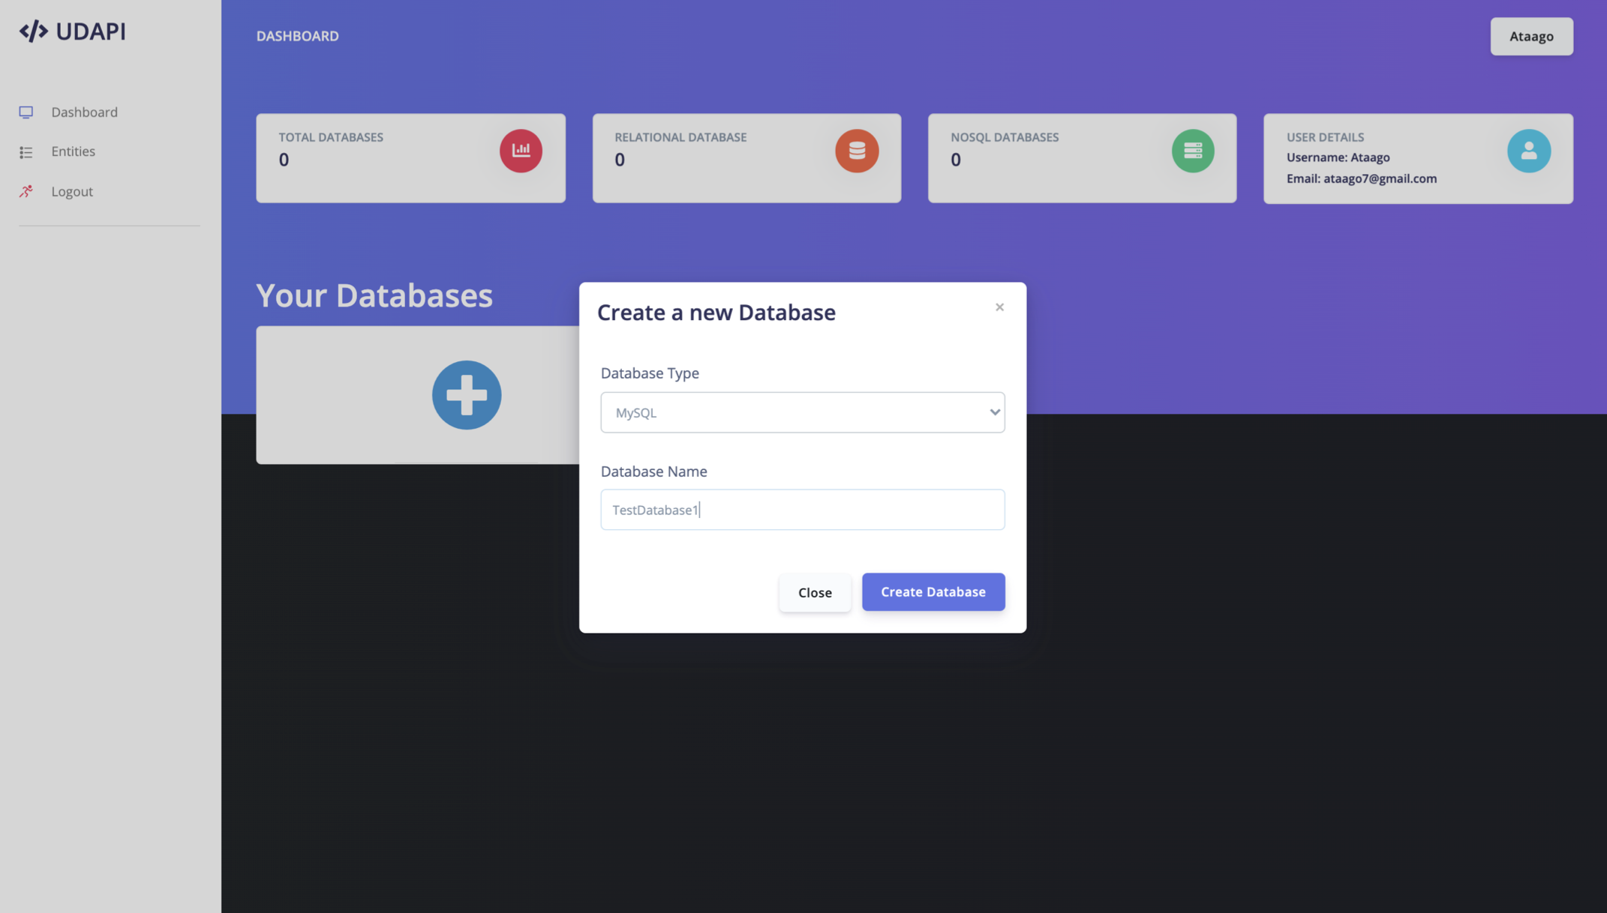
User Interface: Create Databases
Department of Computer Science & Engineering, DSCE

Slide 17
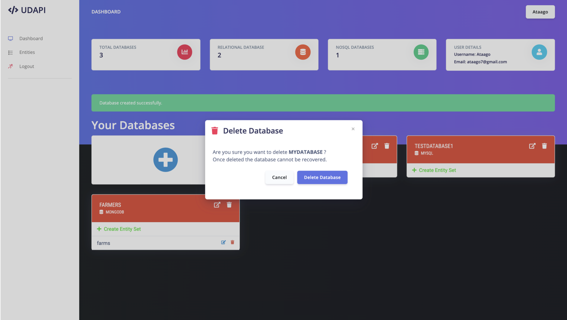
User Interface: Delete Database
Department of Computer Science & Engineering, DSCE

Slide 18
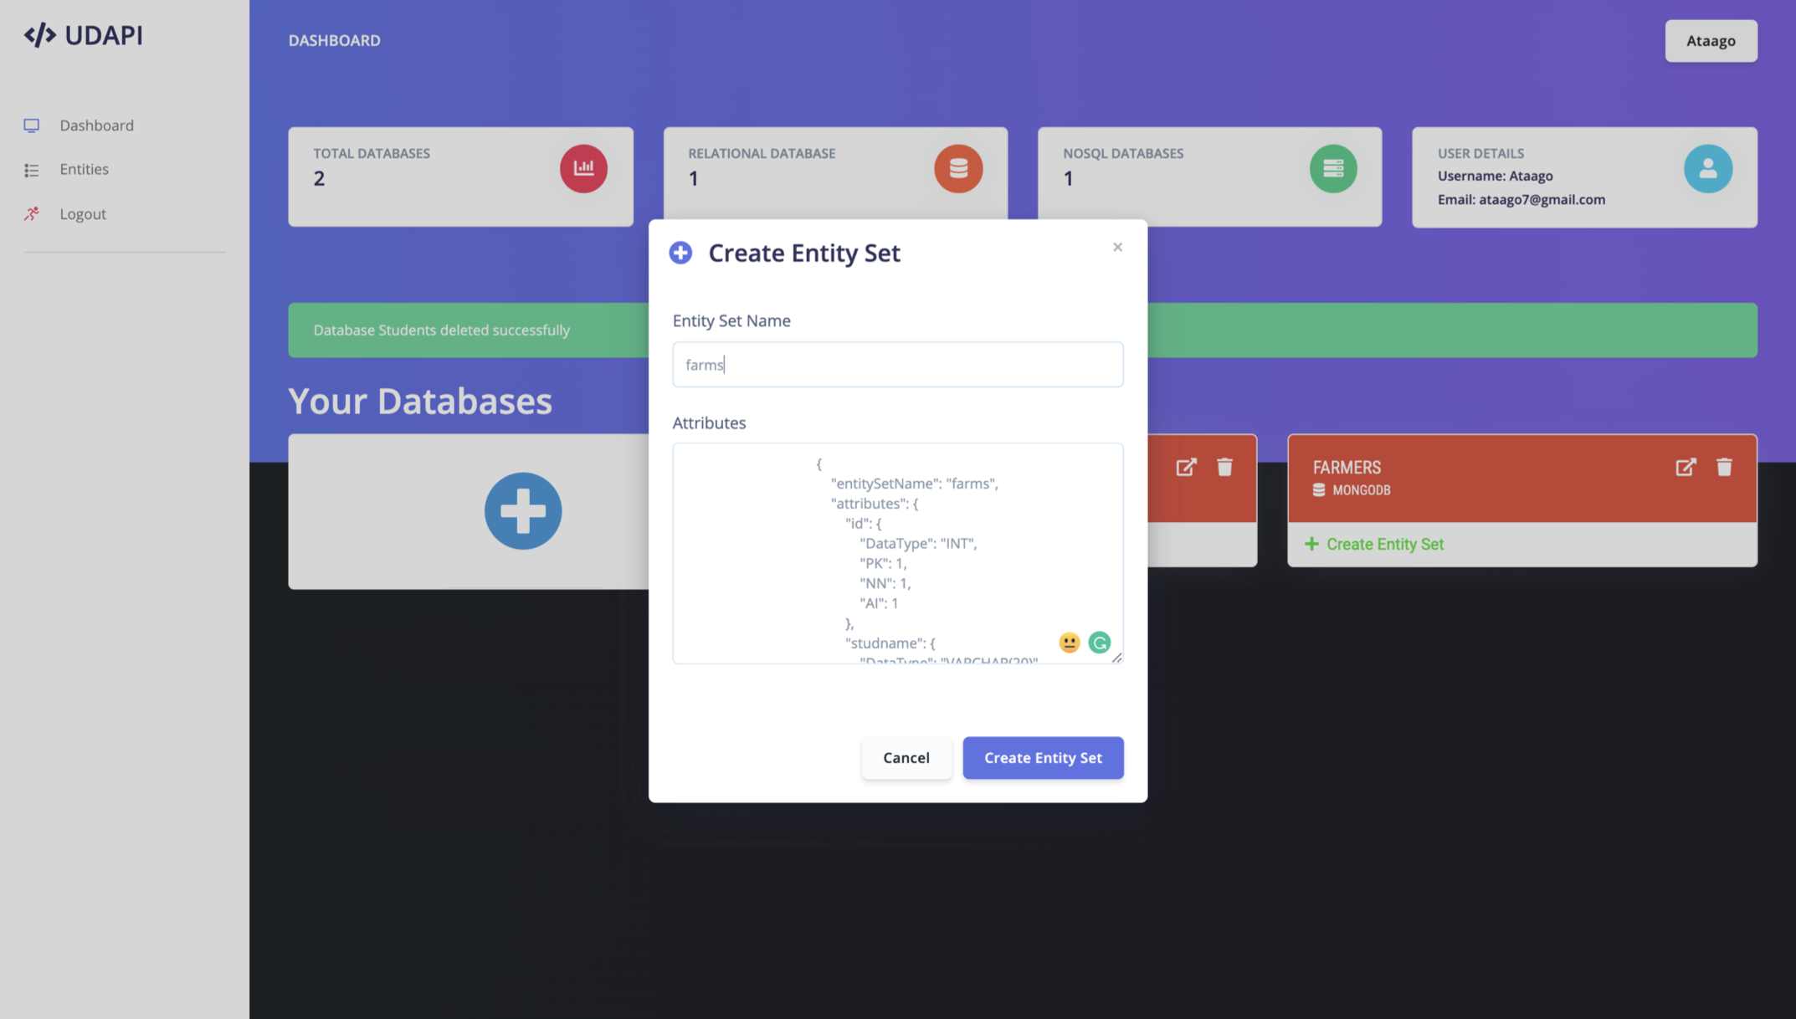
User Interface: Create Entity Set
Department of Computer Science & Engineering, DSCE

Slide 19
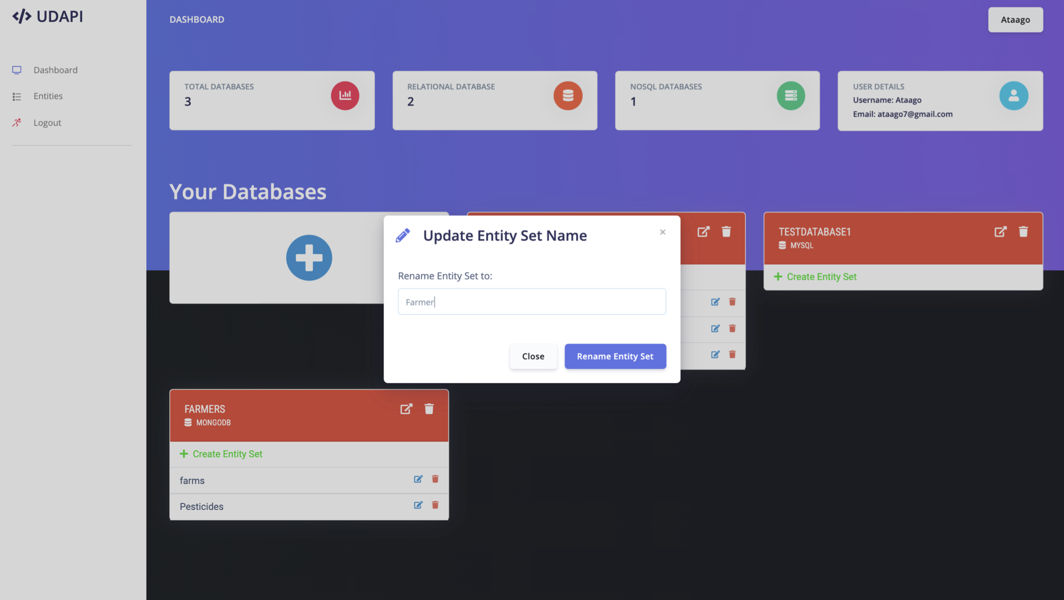
User Interface: Update Entity Set
Department of Computer Science & Engineering, DSCE

Slide 20
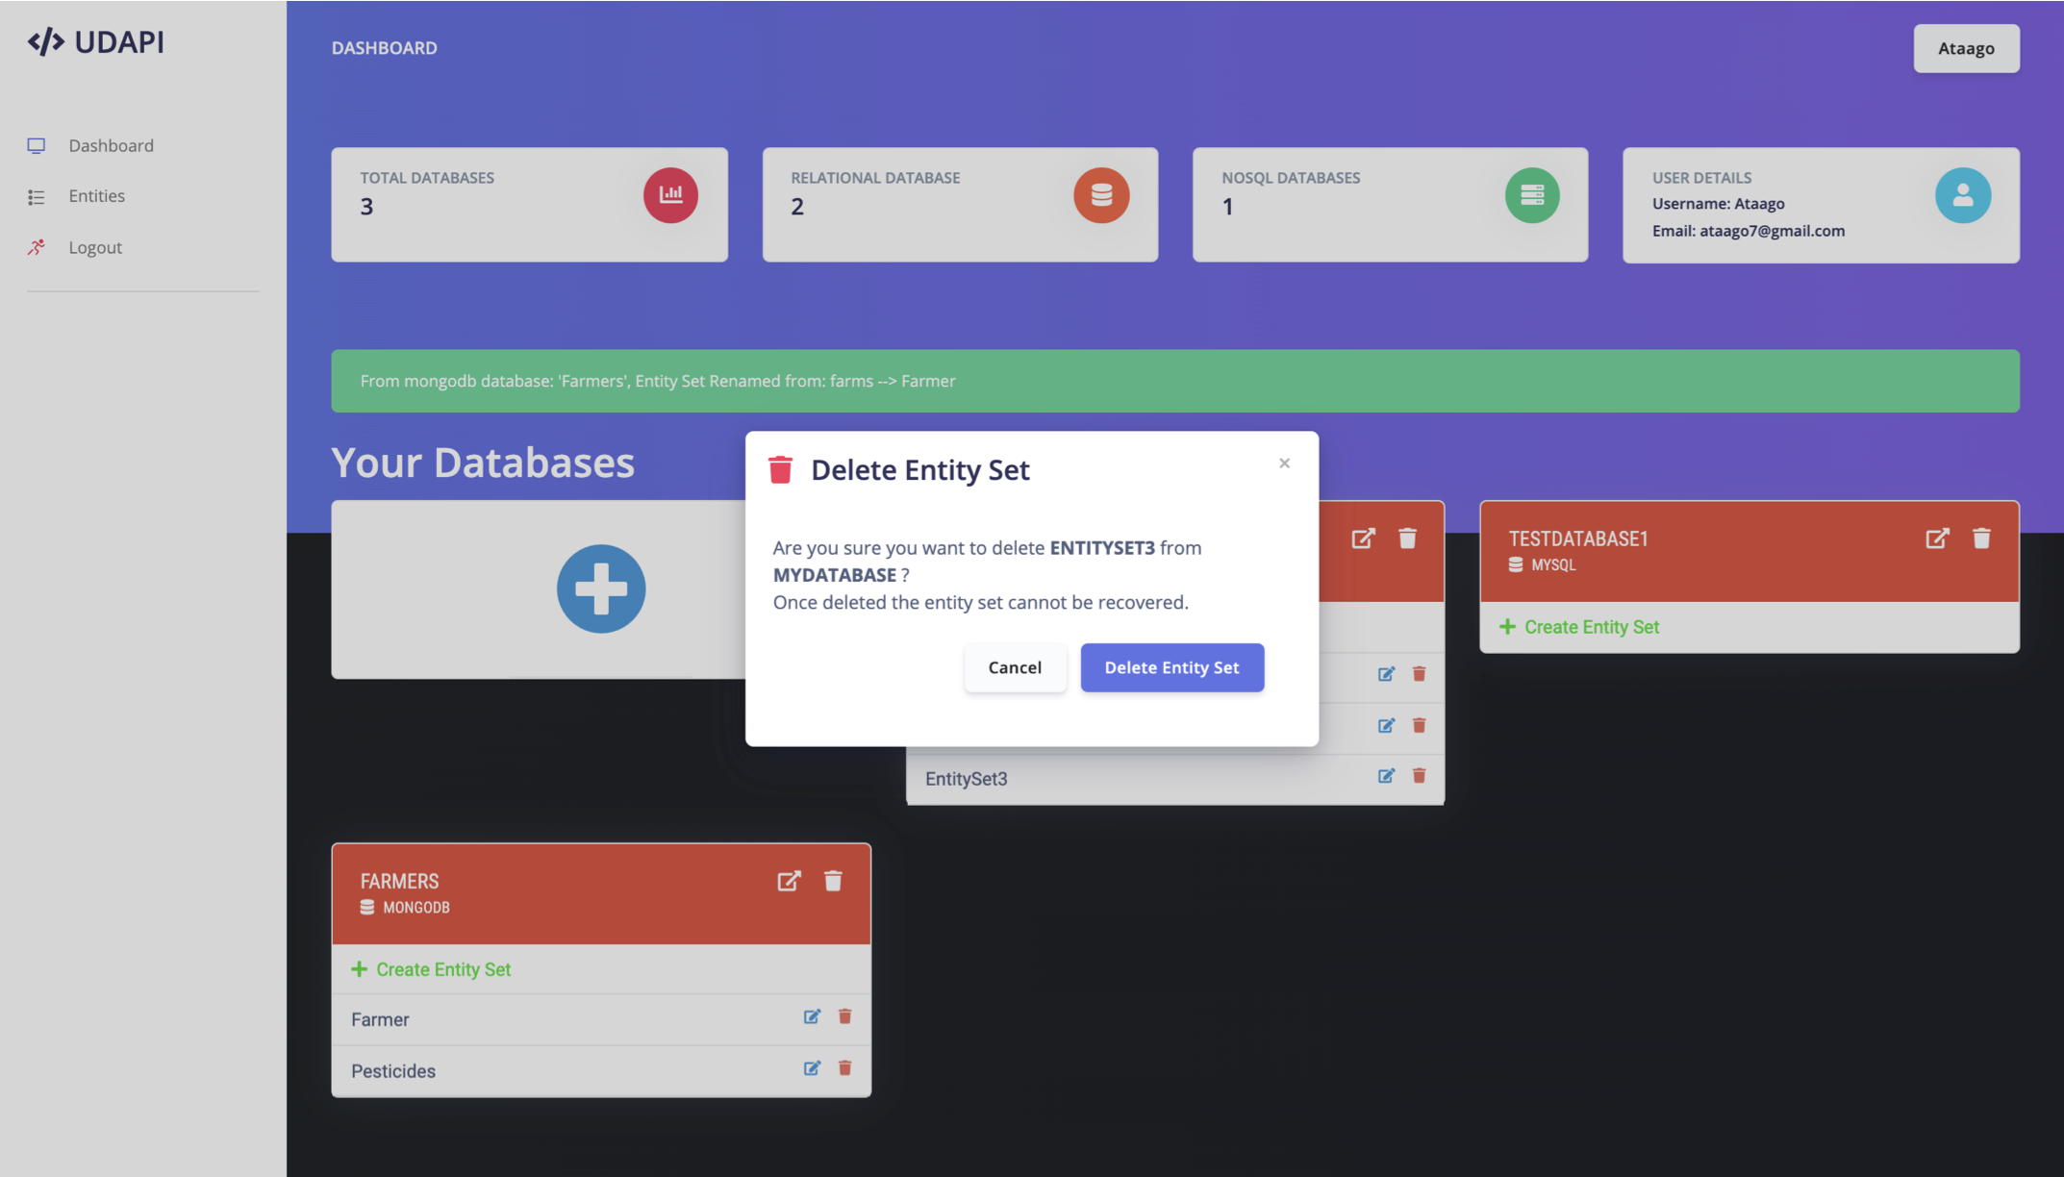
User Interface: Delete Entity Set
Department of Computer Science & Engineering, DSCE

Slide 21
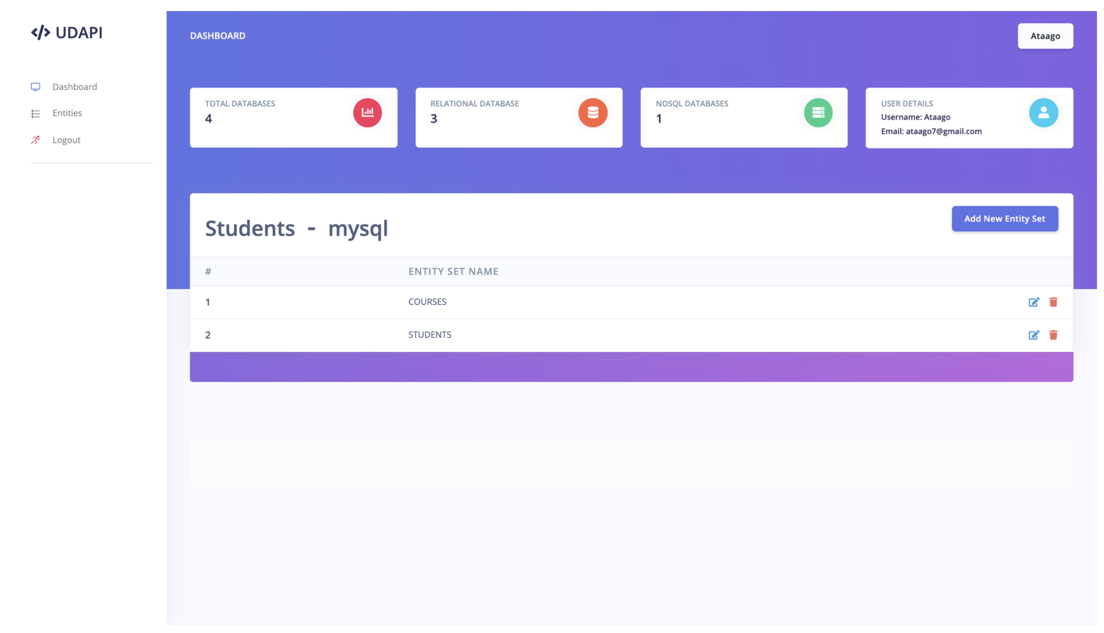
User Interface: Details of Database
Department of Computer Science & Engineering, DSCE

Slide 22
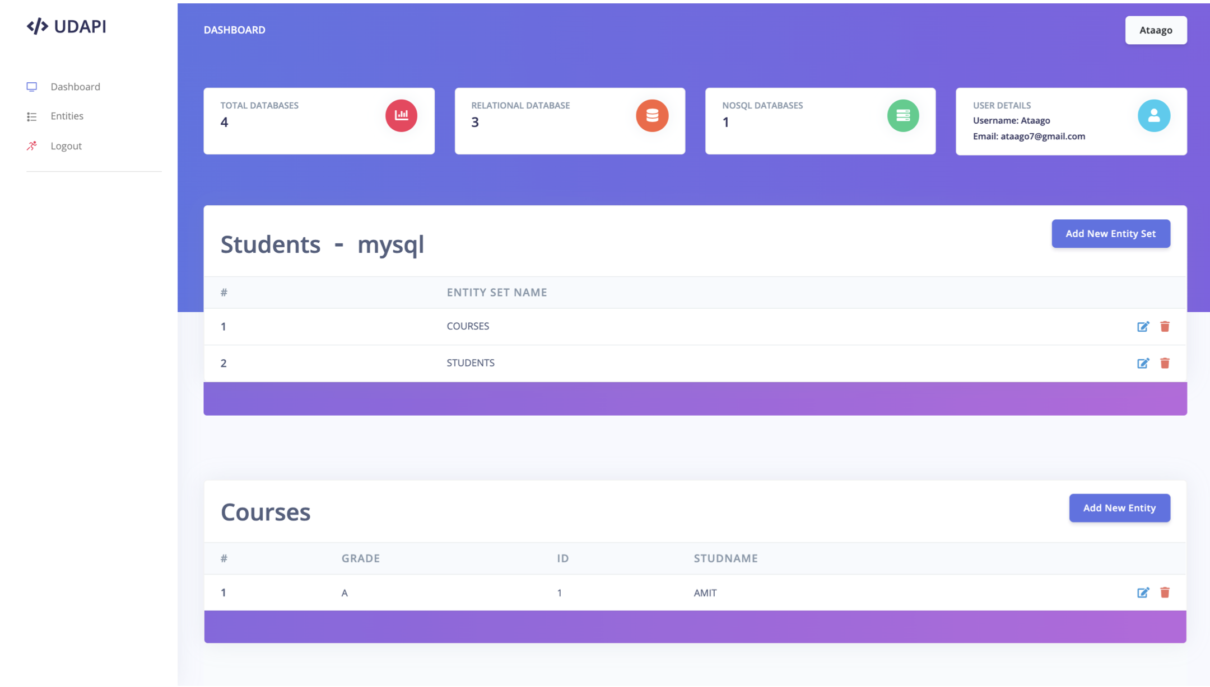
User Interface: view Entity
Department of Computer Science & Engineering, DSCE

Slide 23
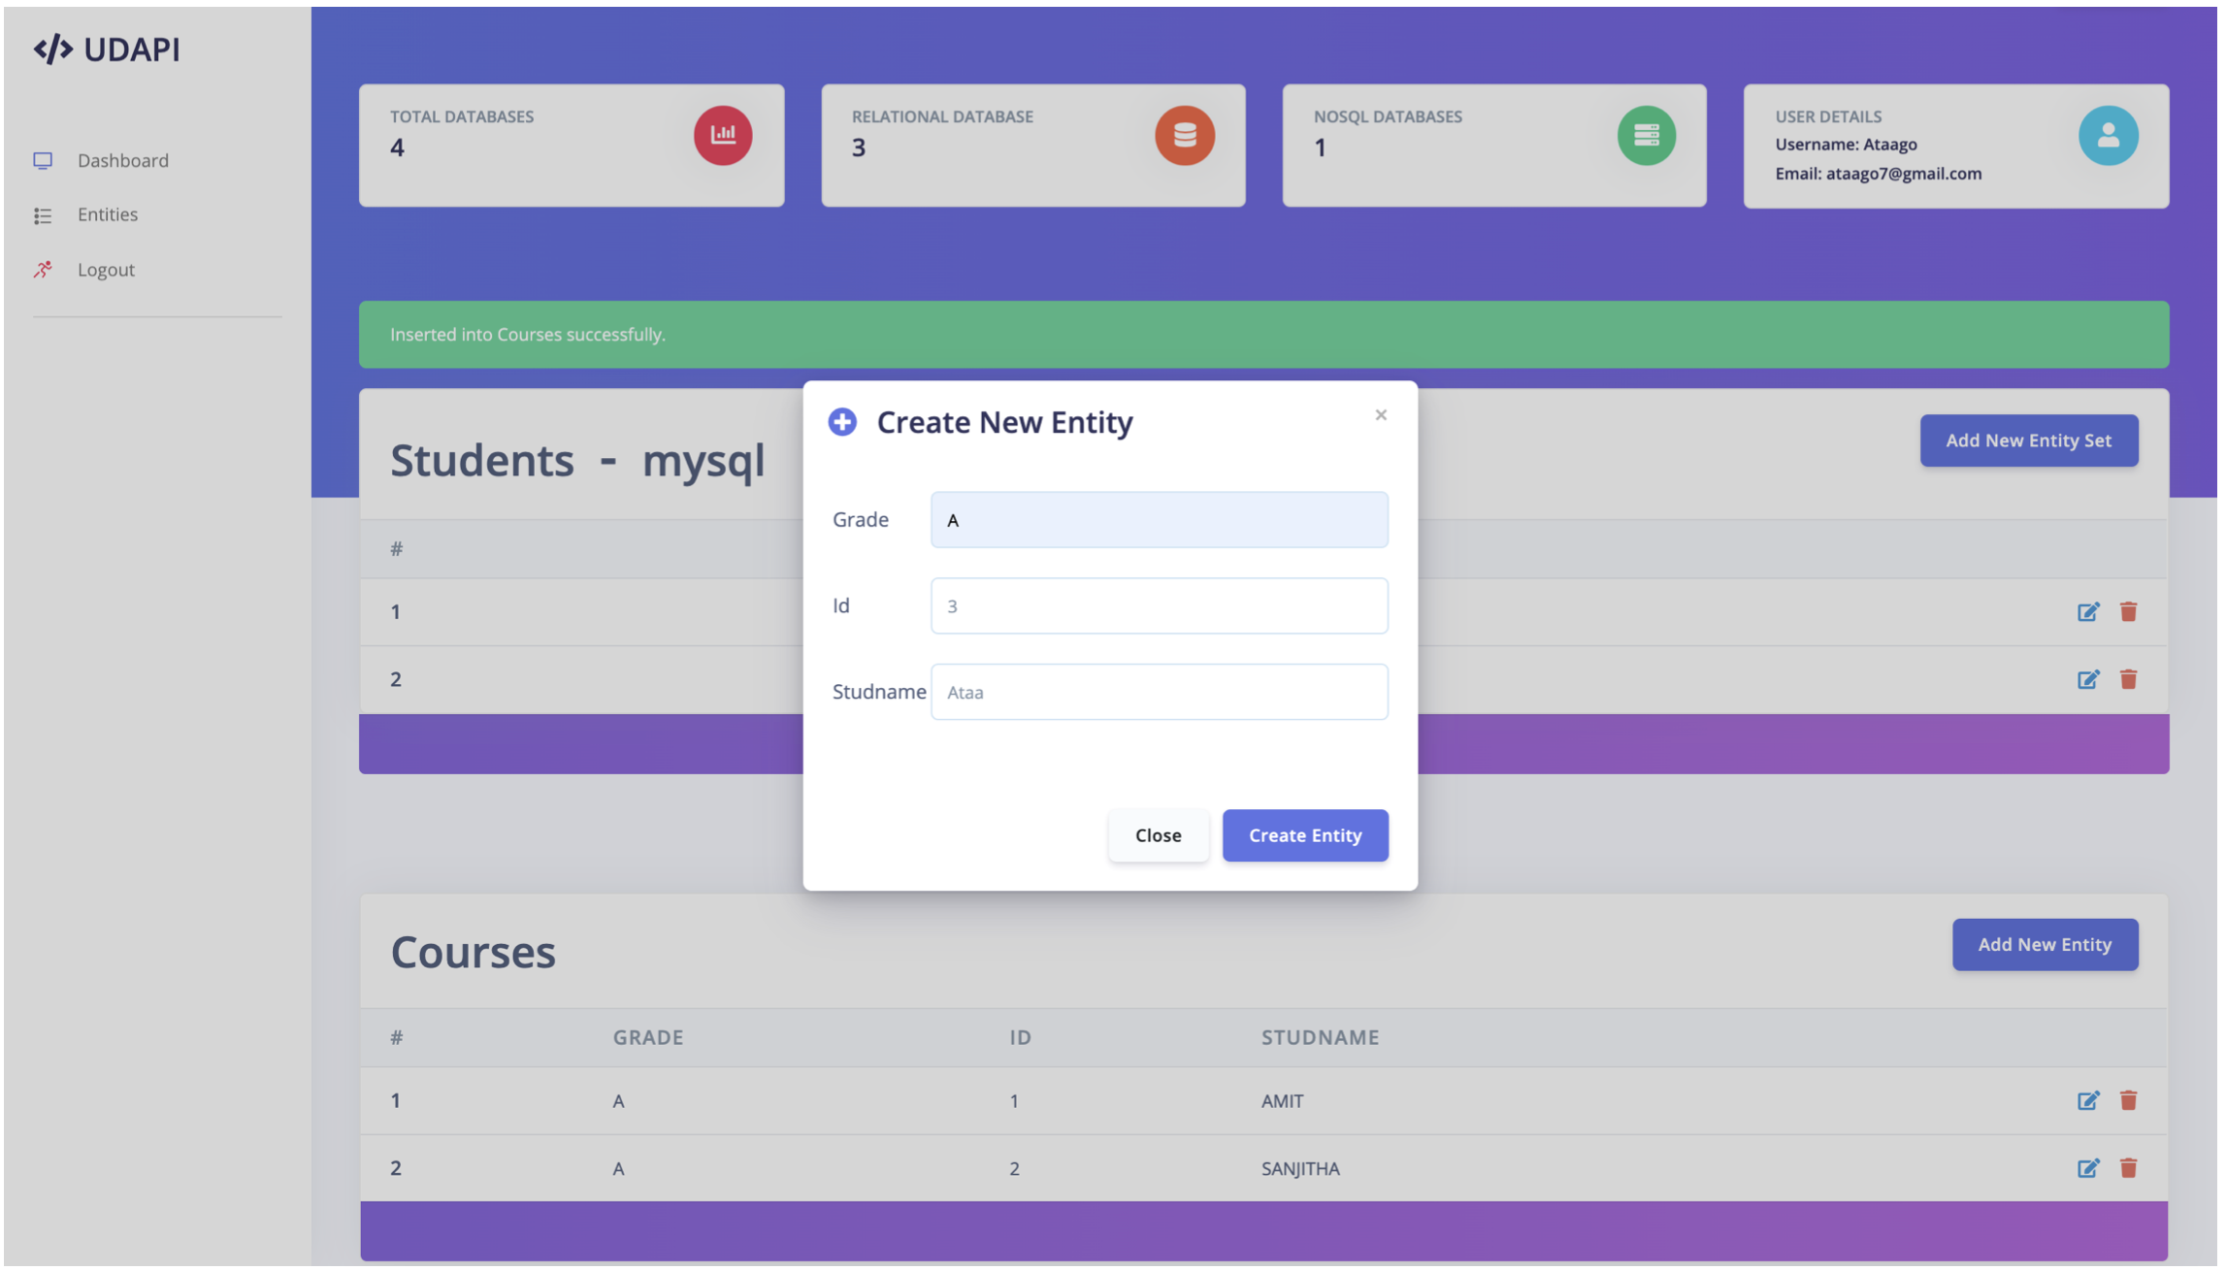
User Interface: Create Entity
Department of Computer Science & Engineering, DSCE

Slide 24
Conclusion
UDAPI, adapted from Sellami et. al’s ODBAPI has implemented all the features the authors theorised about, and has also included its own enhancements. UDAPI is a streamlined and a unified REST API that allows the execution of CRUD operations on different NoSQL and relational databases. It decouples cloud applications from data stores, making the process of migration much easier. Furthermore, it relieves the developers from having to learn new APIs for different databases. UDAPI also has authentication and authorisation to ensure the security of the users’ data and databases. There is still a long way to go but UDAPI is on its way to becoming a reliable one-stop-shop for all database needs.
Department of Computer Science & Engineering, DSCE

Slide 25
Future Work
At present, UDAPI only works for two databases : MySQL and MongoDB. Other databases can be supported in future iterations of the development process.
The process of creating entity sets takes JSON requests in the user interface. This could be modified into a much more intuitive form with dynamic input fields that can be added or deleted based on the number of attributes.
The Front-end can be further enhanced to include a POSTMAN like feature where the user could directly interact with UDAPI for quick requests and responses.
Tools can be provided for quick migration of datastore from one datastore to another with the press of a button. We hope to include all of these in the near future.
Department of Computer Science & Engineering, DSCE

Slide 26
Key References
C. Baun, M. Kunze, J. Nimis, and S. Tai,Cloud Computing- Web-Based Dynamic IT Services. Springer, 2011.
B. F. Cooper and et al., “Pnuts: Yahoo!’s hosted data servingplatform,”PVLDB, vol. 1, no. 2, pp. 1277–1288, 2008
M. Pollack, O. Gierke, T. Risberg, J. Brisbin, and M. Hunger,Eds.,Spring Data. O’Reilly Media, October 2012.
Department of Computer Science & Engineering, DSCE

Slide 27
Thank You
Department of Computer Science & Engineering, DSCE

